Slide 1
Produce API .Net Core

Slide 2

What is API?

Slide 3
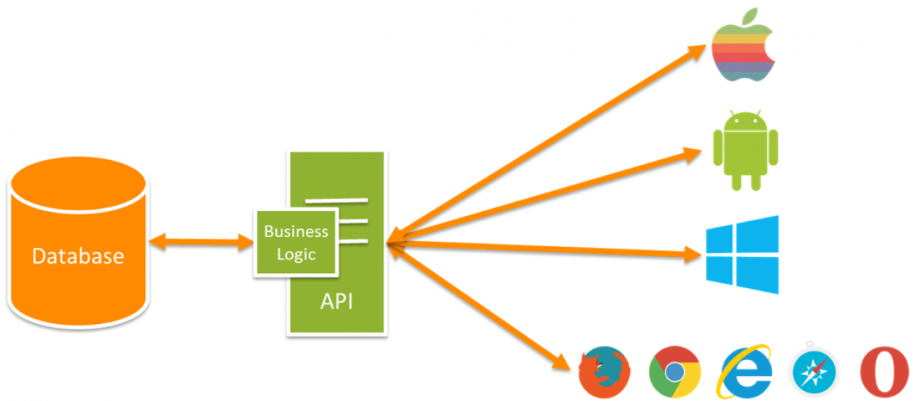
API stands for Application Programming Interface which allows developers to integrate two parts of an application or with different applications at the same time

Slide 4
Web API Features
To create a Web API, several things that must be provided are:
Supports CRUD function that works over HTTP protocol with GET, POST, PUT and DELETE methods
Has an Accept Header response and HTTP status code
Response with JSON, XML or whatever format you want. However, it is mostly used in JSON format.
Supports MVC features such as routing, controllers, action results, filters, models, IOC containers, etc.
The web API can run on Apache or other supported web servers according to the programming language used.

Slide 5
References
https://www.codepolitan.com/mengenal-apa-itu-web-api-5a0c2855799c8

